Slide 1
Predicting Thermal Conductivity in Nuclear Fuels using Rattlesnake-Based Deterministic Phonon Transport Simulations
Jackson R. Harter
M.S. Defense
Oregon State University
October 1, 2015

Slide 2
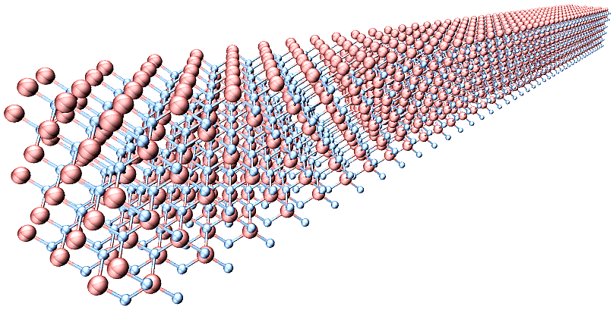
Outline
Motivation
Phonon Transport Physics
Research Goals
Methods
Results
Conclusions
Future Work

Slide 3
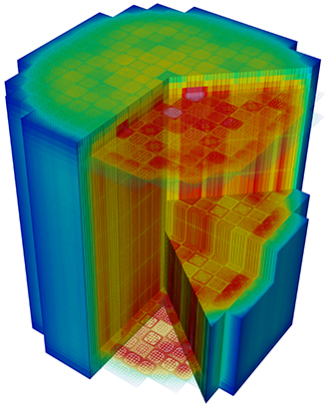
Motivation
Thermal conductivity is tied to many processes in nuclear reactors
Neutron macroscopic cross section is a function of temperature, which is dependent on thermal conductivity
Traditionally obtained by experimental measurement
Destructive measurement techniques
Computational simulation approach is attractive
Nondestructive technique, associated uncertainty
Speed and accuracy are desired
Must know isotope concentration, temperatures, material properties
UMich Engineering

Slide 4
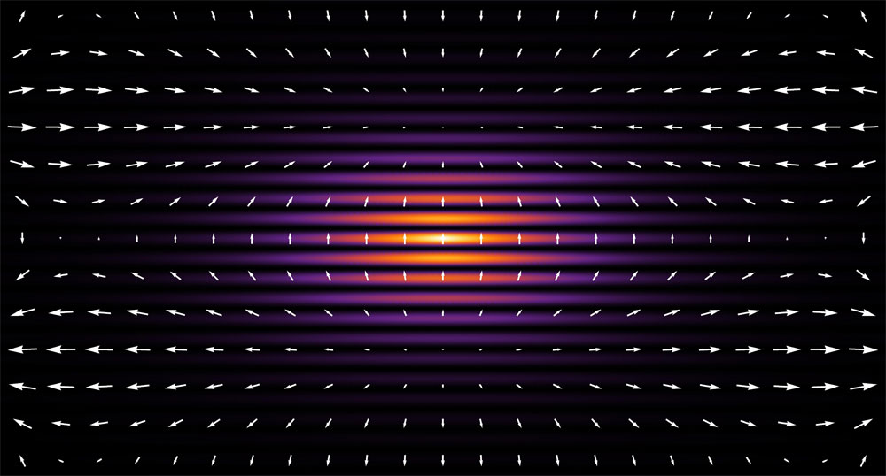
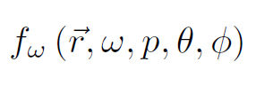
Phonon Transport Physics
Phonons are the quantization of lattice vibrations
Phonon energy associated with vibrations of atoms, displacement from equilibrium
A ‘quasiparticle’
Scattering kernel involve phonon frequency distribution
Phonon scattering is dominant mechanism affecting thermal transport in ceramic based materials
Electrons dominant carrier in metallic materials
Sea of free electrons in metals versus a more bound structure in ceramics
Departure from Fourier regime of heat transfer
Characterization of effects at the nanoscale
Boltzmann transport equation necessary to model thermal transport
C. Tahan/Laboratory for Physical Sciences

Slide 5
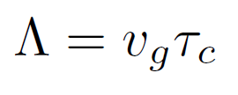
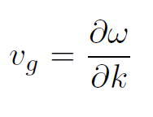
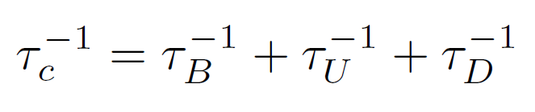
Phonon Transport Physics
Phonon mean free path
Product of group velocity and relaxation time
Average distance traveled before next scattering event
Bulk parameter, influenced by many processes
Group velocity
Dispersion relation
Frequency to wave number
Acoustic branch
Optic branch
Relaxation time
Mean time between interactions
Size effects
Normal and Umklapp processes
Lattice imperfections

Slide 6
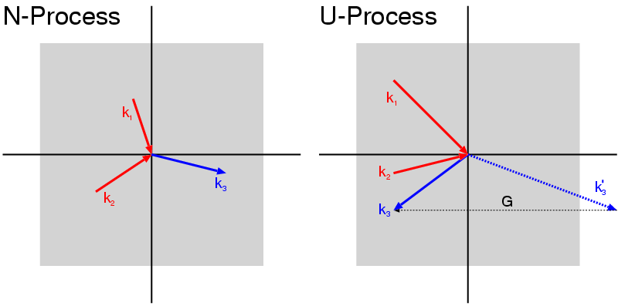
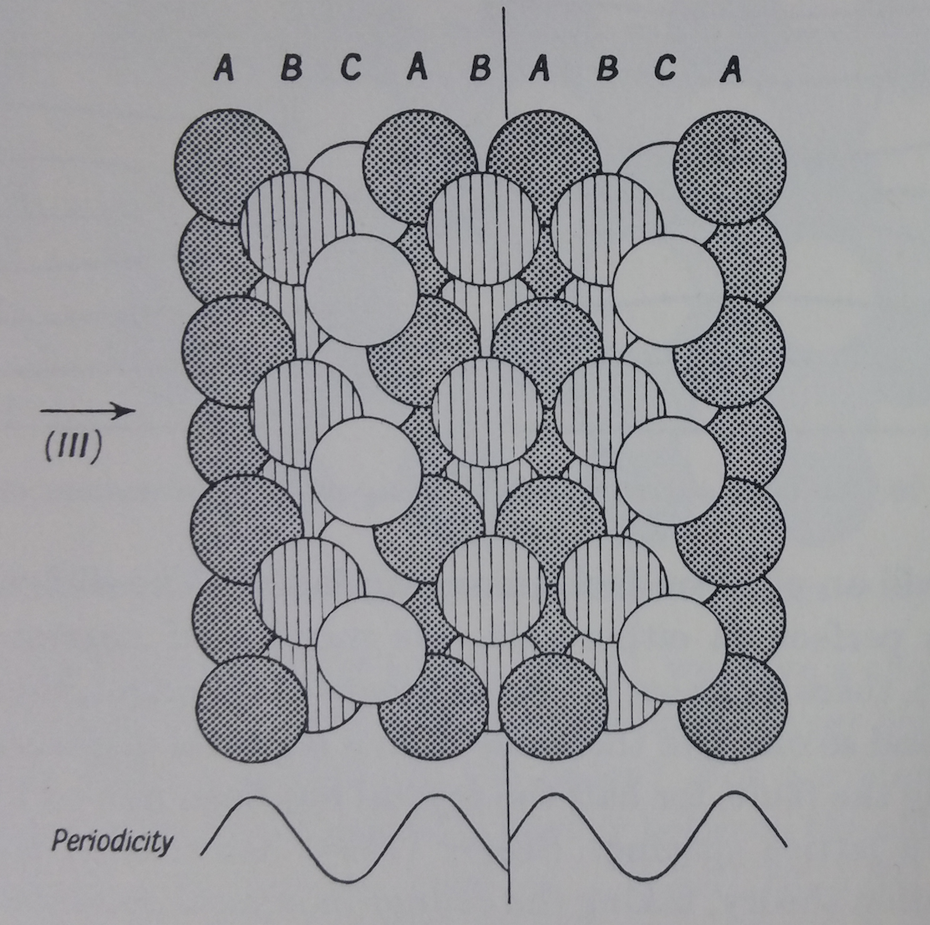
Phonon Transport Physics
Normal and Umklapp processes
Three phonon collision processes are anharmonic
Phonons not conserved
Normal processes conserve momentum
Do not have wave vectors larger than first Brillouin zone
Umklapp processes change momentum
Process of dissipation, diffusive mechanic
Scattering by lattice imperfections
Interatomic potential consideration
Very prevalent scattering processes
Point defects
Grain boundaries
Twin boundaries
Stacking faults
D. Schwen
Ziman/Electrons and Phonons

Slide 7
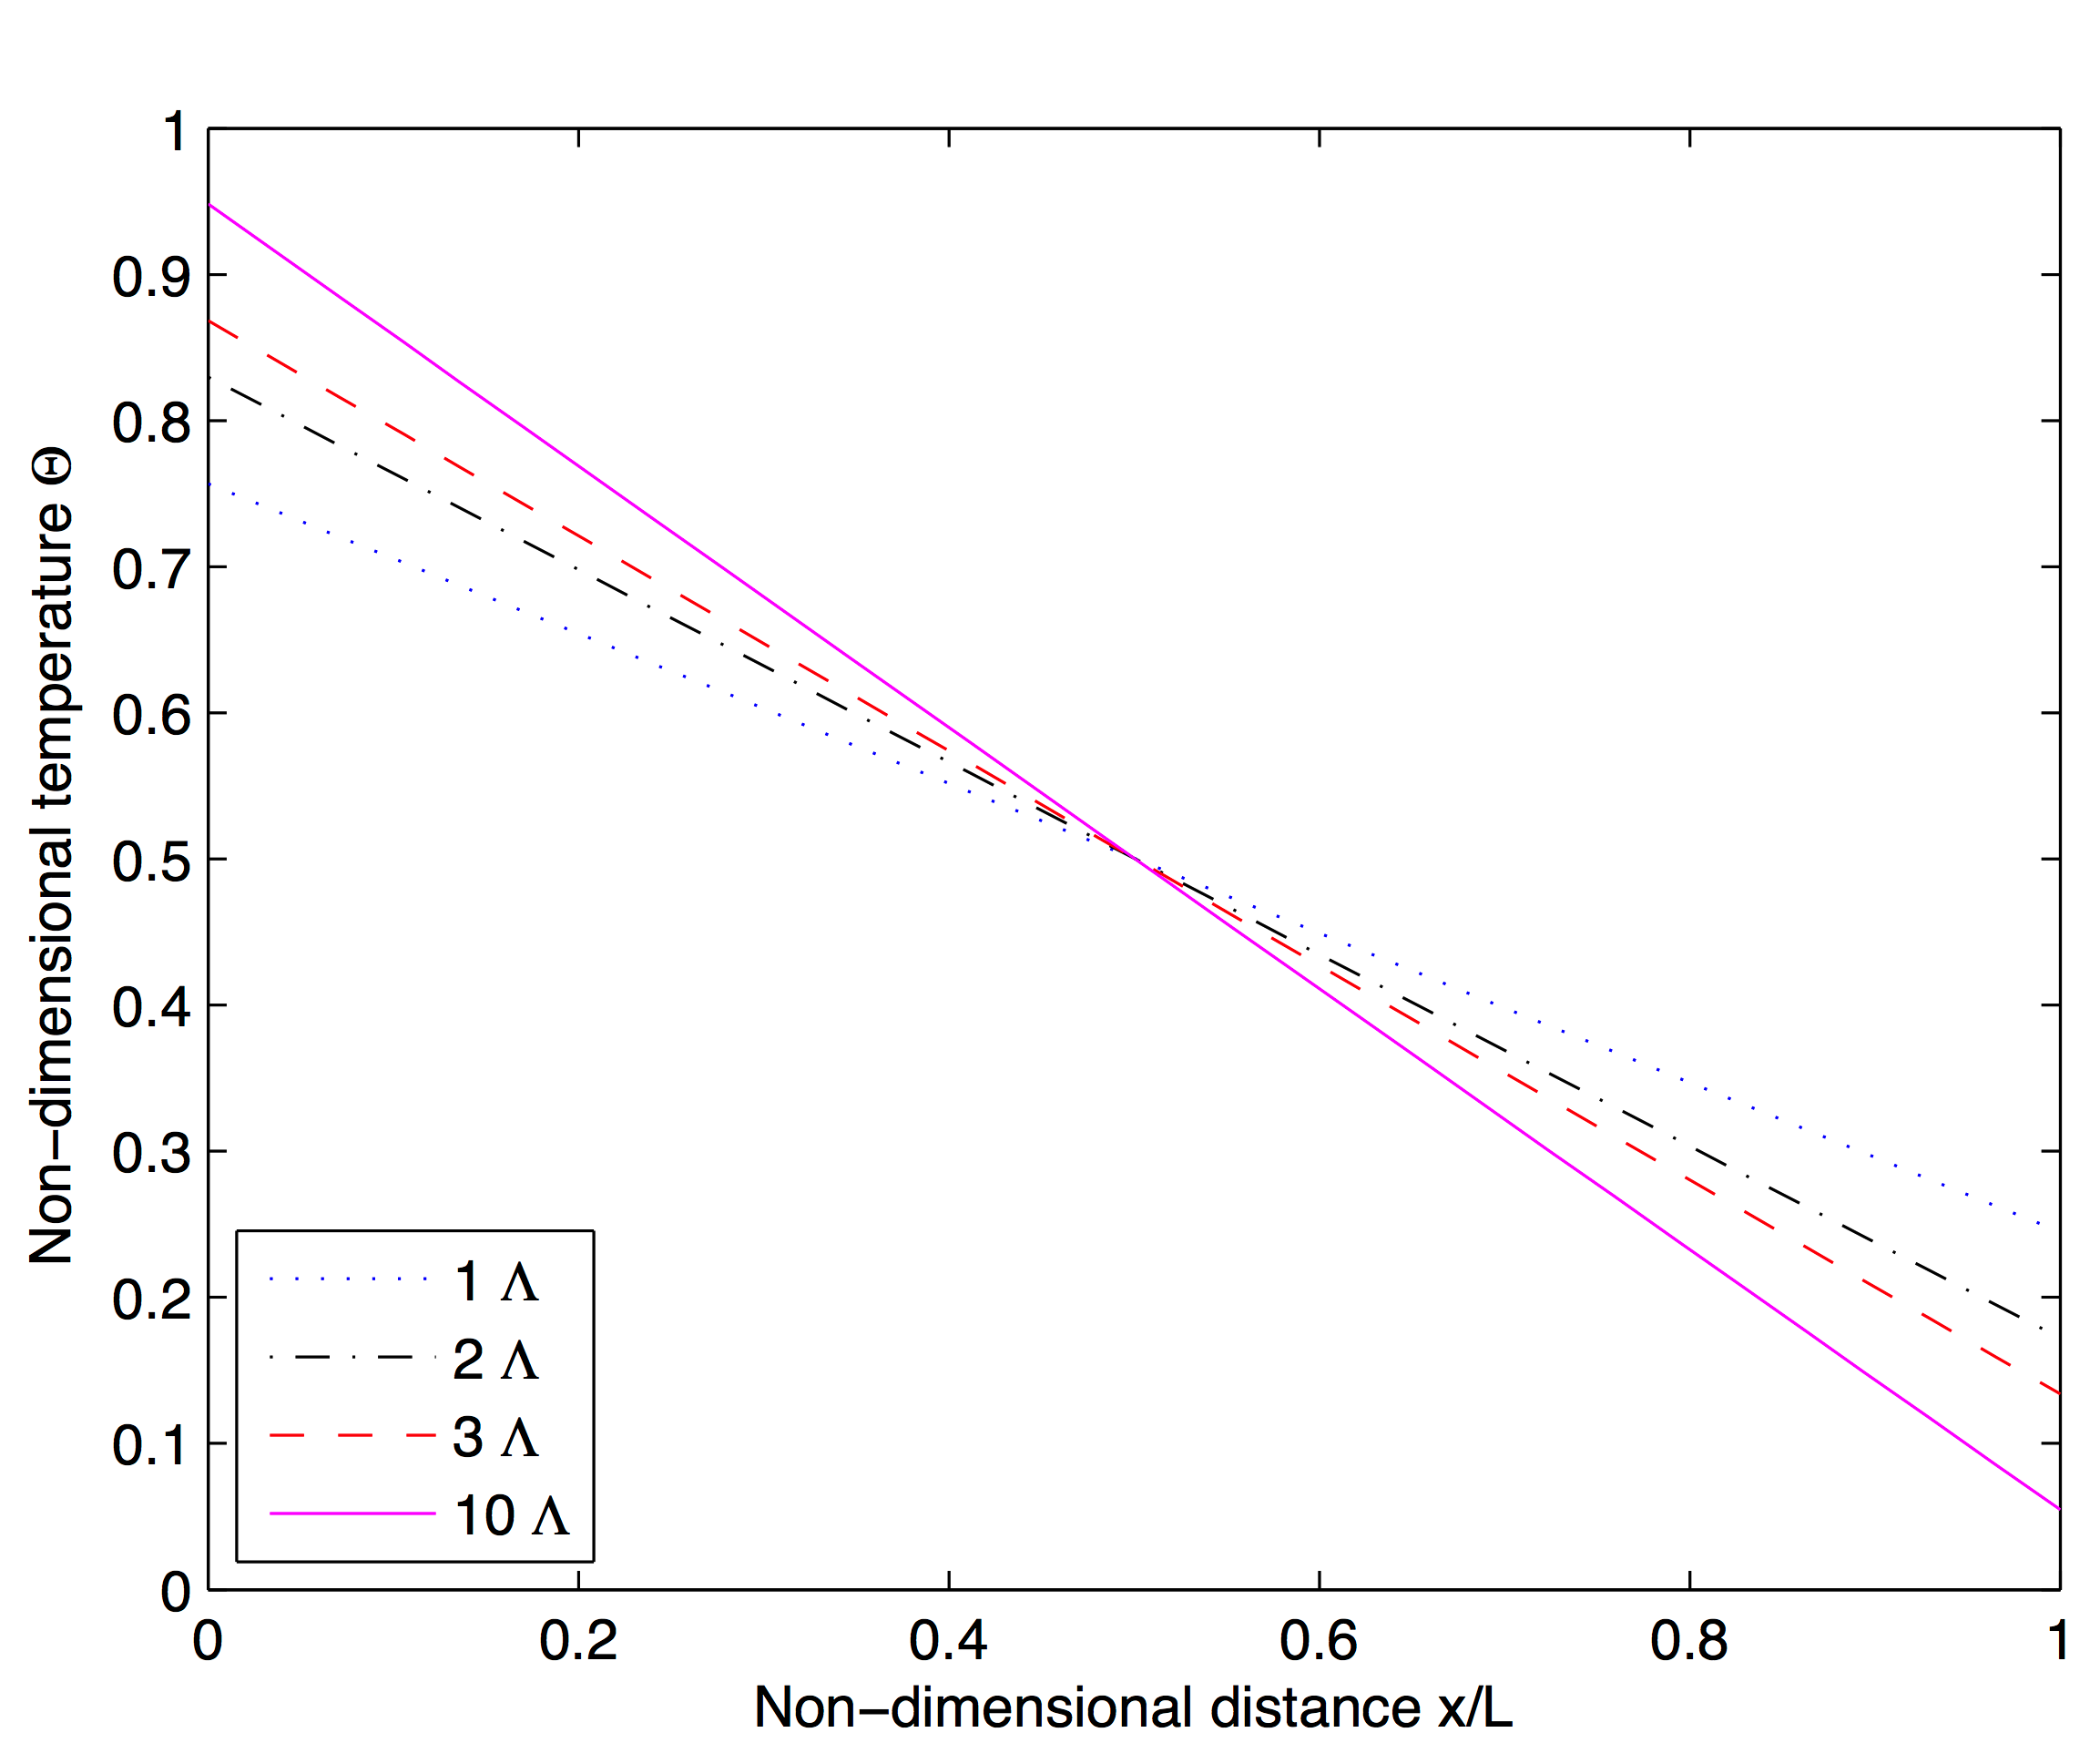
Phonon Transport Physics
Size effects
Departure from Fourier heat conduction regime
Surface roughness, material geometry
Casimir limit
Acoustically thin– ballistic scattering
Acoustically thick – diffuse scattering
Heated surfaces emit phonons
Relationship with specific heat capacity, group velocity
Opposing distributions see step change at boundaries

Slide 8
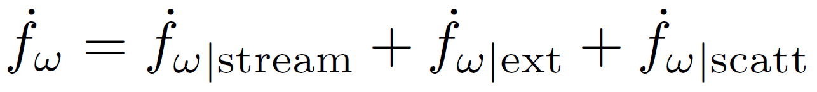
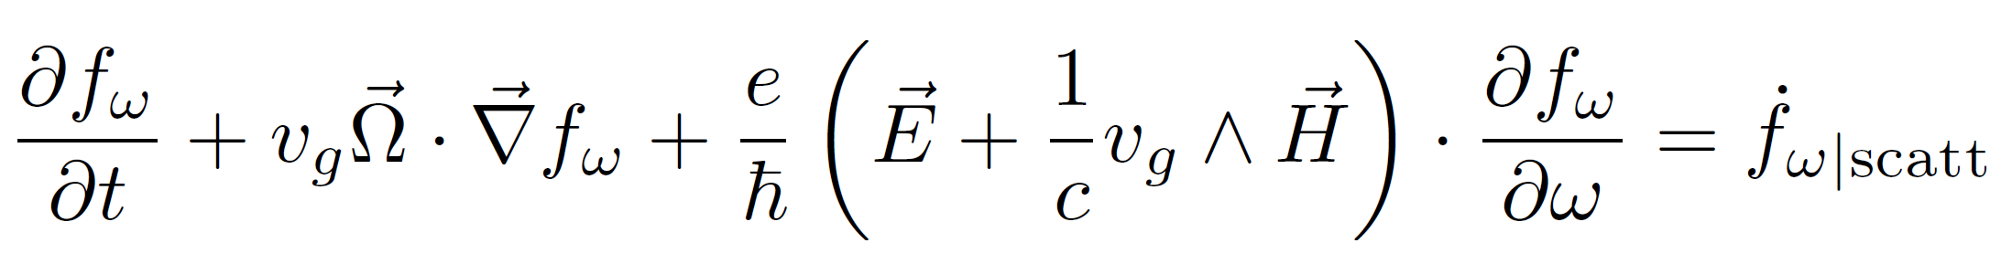
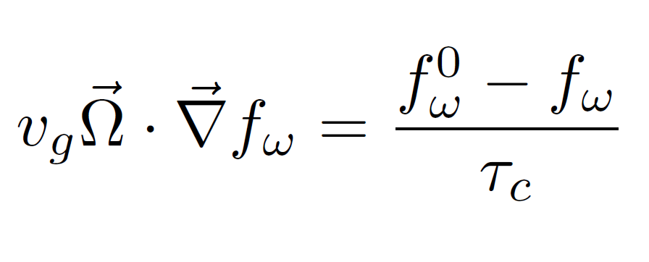
Phonon Transport Physics
Boltzmann Transport Equation for phonons
Steady state, no internal heat generation, no external fields
Relaxation time approximation (RTA)

Slide 9
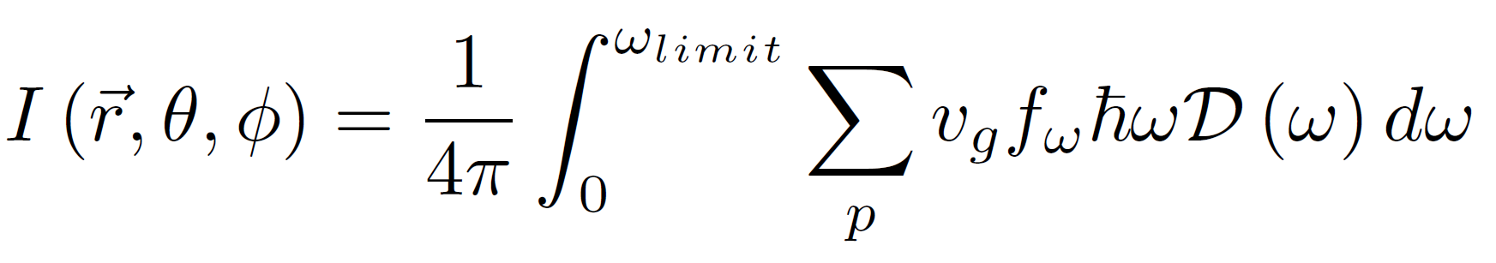
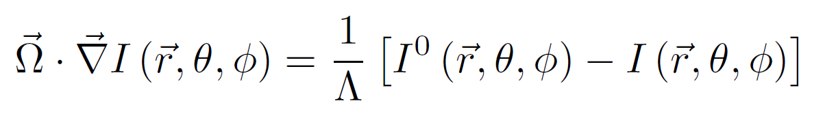
Phonon Transport Physics
This research assumes frequency independent (grey) phonon transport
Equation of Phonon Radiative Transfer (EPRT)
Summation over polarizations, density of states and all frequencies

Slide 10
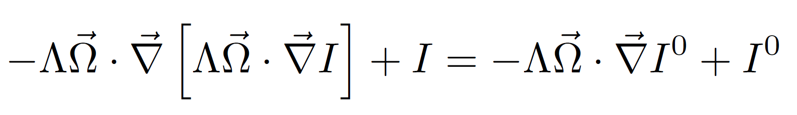
Phonon Transport Physics
The Self-Adjoint Angular Flux formulation
Algebraic manipulation of the first order transport equation for phonons
Second order form
Full angular intensity is the unknown
Allows for solution through continuous finite element mesh (CFEM) techniques

Slide 11
Research Goals
Simulate phonon transport using a neutron transport code in the Self-Adjoint Angular Flux formulation
Most phonon transport simulated with molecular dynamics or Monte Carlo methods
Bridge the gap between molecular dynamics and engineering scale simulations
Characterize bulk, heterogeneous nuclear fuels with fission product defects
UO₂, PuO₂
Xenon is the dominant fission product disrupting thermal transport in UO₂
Conduct uncertainty analysis using a deterministic application of the polynomial chaos expansion method
Wide range of uncertainty associated with phonon mean free path

Slide 12
Computational Methods of Phonon Transport
Monte Carlo
Randomized simulations provide highly accurate results
Tailored physics to model array of transport effects
Exceptionally slow to converge
Molecular Dynamics
Use interatomic potentials to model interactions at an atomistic scale
Limited by system size and high computational cost
Deterministic
Use discrete ordinates to discretize the angular variable
First order physics-based approach
Obtain moments of phonon intensity to compute temperature, heat flux and thermal conductivity
Faster than MC and MD

Slide 13
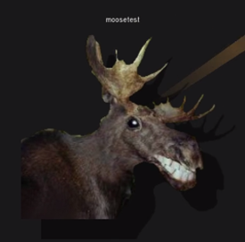
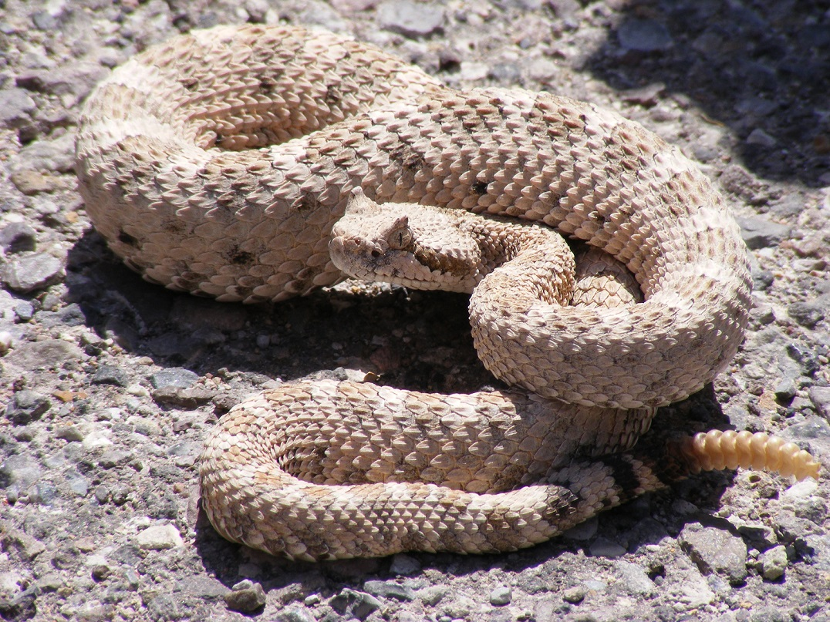
Methods
MOOSE
Multi-physics Object Oriented Simulation Environment
Sophisticated framework for solving coupled PDEs
Massively parallelizable
Finite element spatial mesh
Dimension agnostic
Krylov solvers with preconditioning
Rattlesnake
Solves the Boltzmann transport equation for neutrons
Self-Adjoint Angular Flux formulation
CFEM
S_{N} or P_{N} angular discretization, acceleration
mooseframework.org
wikipedia.org

Slide 14
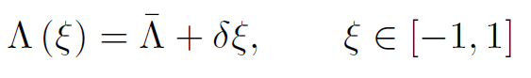
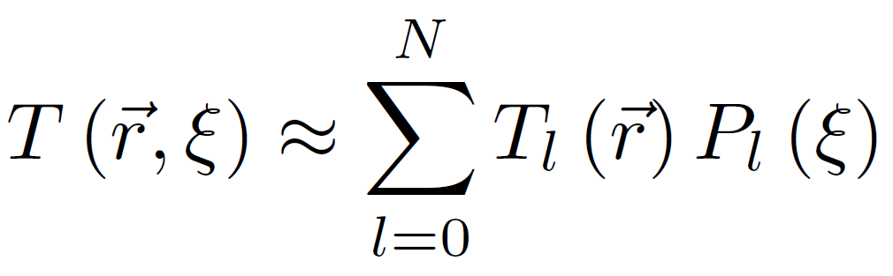
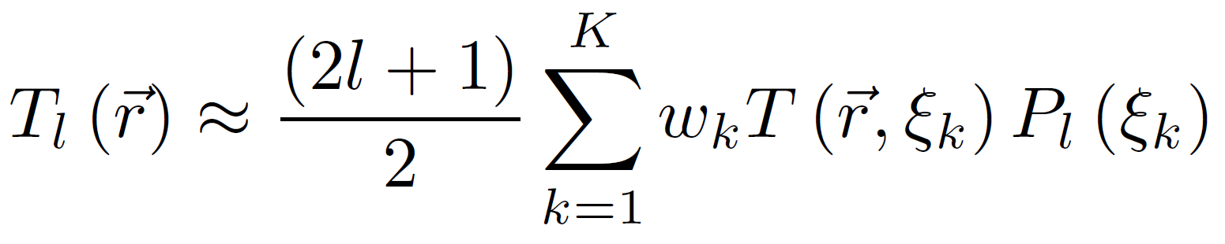
Methods
Uncertainty quantification provided through polynomial chaos expansion
PCE with stochastic collocation, PCE-SC
Phonon mean free path may be quite uncertain, 30-50% of mean in some cases
Replaces brute force Monte Carlo, using “deterministic” sampling to replace integral in moment equation (Dulla et al., Prinja)
Maps the uncertain variable to a linear distribution [-1,1]
Zeroth moment gives mean, summation of higher moments for variance

Slide 15
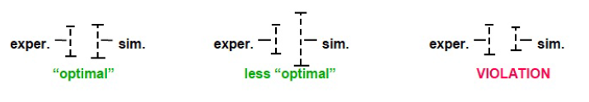
Methods
PCE-SC is efficient for problems with few input variables
K^{N} calculations
Quadrature set with K directions
N changes with number of uncertain variables
PCE-SC is a nonintrusive method
No alteration of governing equations
Computations performed with uncertainty equivalent to predictive simulation
Considering two forms of uncertainty
Aleatory – mathematical “noise” from simulations, cannot be reduced
Epistemic – lack of knowledge, can be reduced through developing better models
Truncano et al. (2002)

Slide 16
Results
Transport in Thin Films
Two Material System
Phonon Transport in z-axis Graphite
Single Crystal UO₂
Transport in UO₂ with Xenon Defects

Slide 17
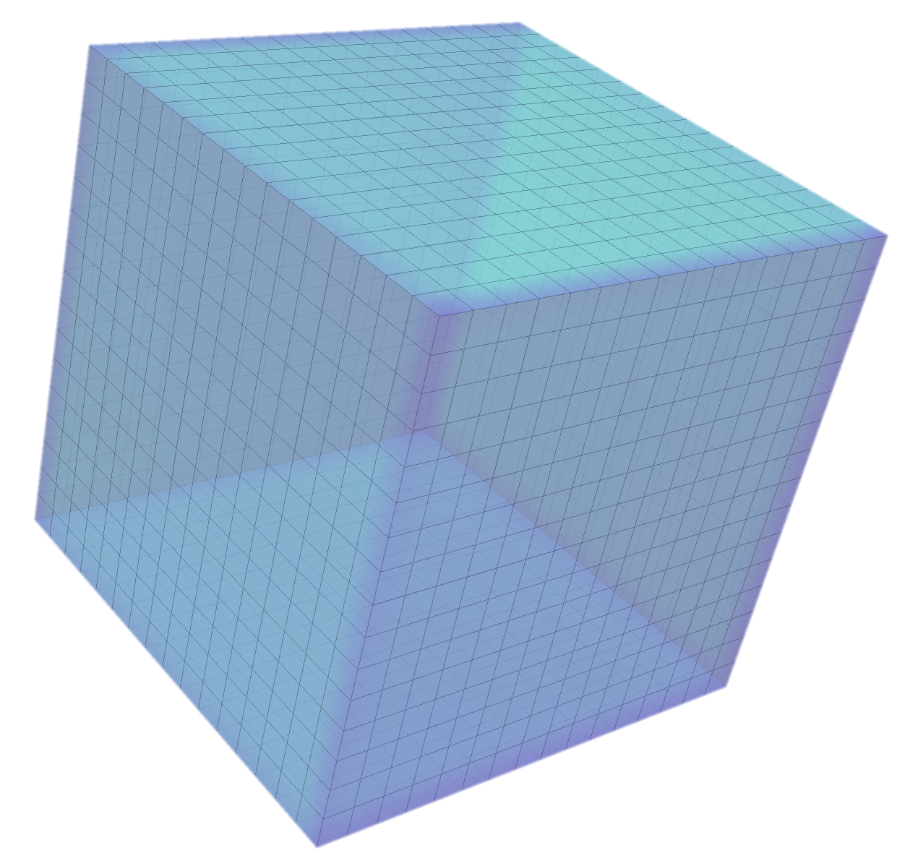
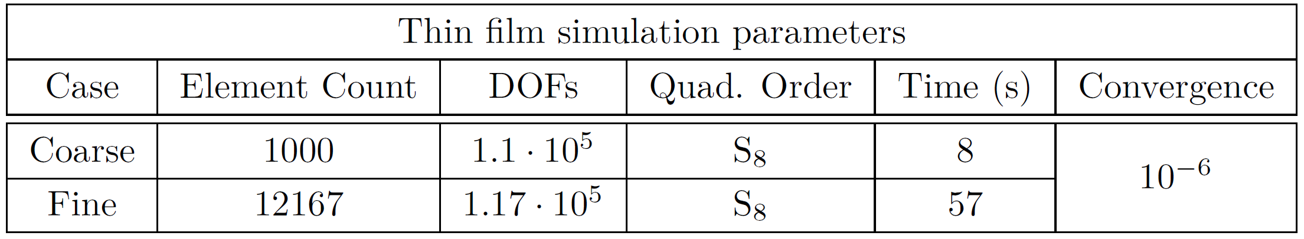
Transport in Thin Films
Thin film problem based on work of Yilbas and Bin Mansoor
Silicon thin film problem widely used to benchmark computational methods
Cube with side lengths 101.4 nm
T_{L} = 301 K, T_{R} = 300 K on z-planes
x-y planes reflecting
Deterministic transport
Yilbas and Bin Mansoor used forward-backward differencing
Results laid framework for continued use of Rattlesnake

Slide 18
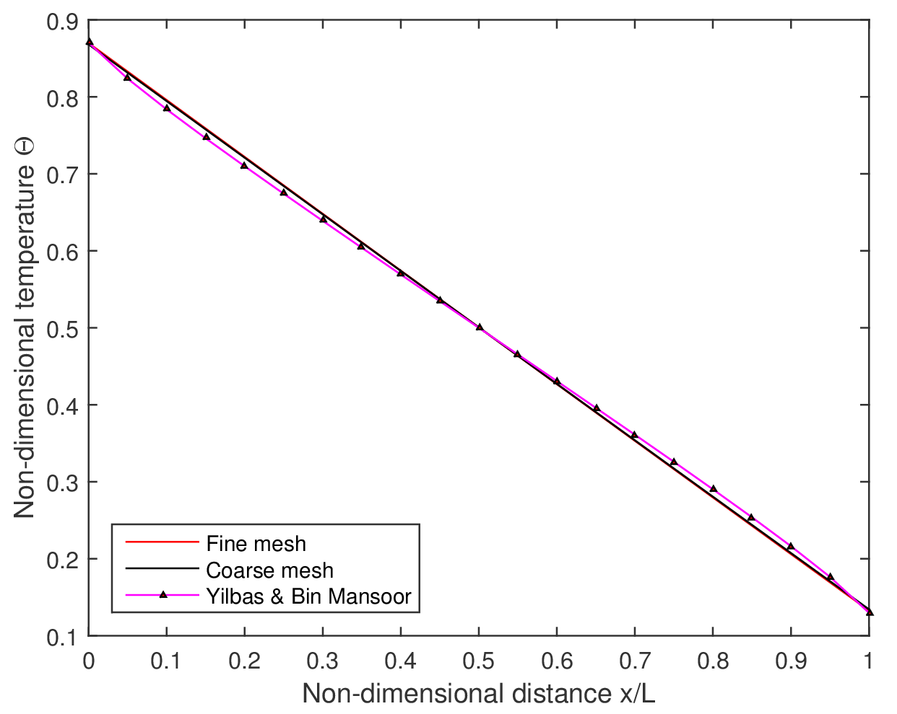
Transport in Thin Films

Slide 19
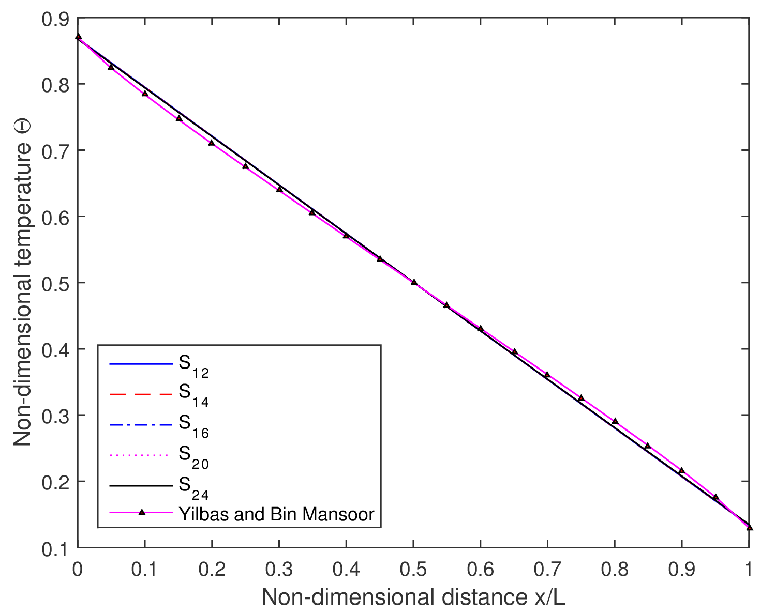
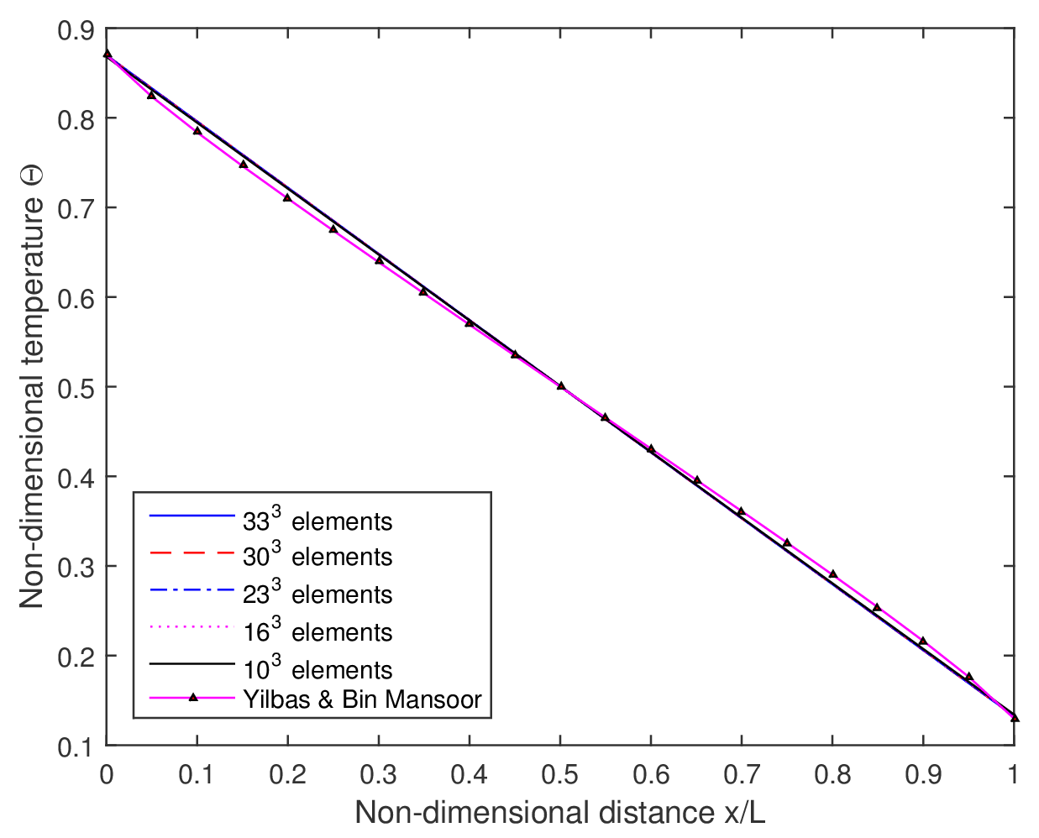
Transport in Thin Films
Quadrature and mesh refinement
Simple geometry homogeneous problems
Minimal quadrature set and element count yields accurate solution (S₂, 1000 element)

Slide 20
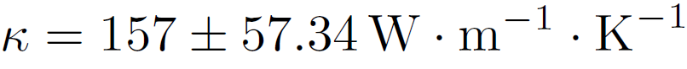
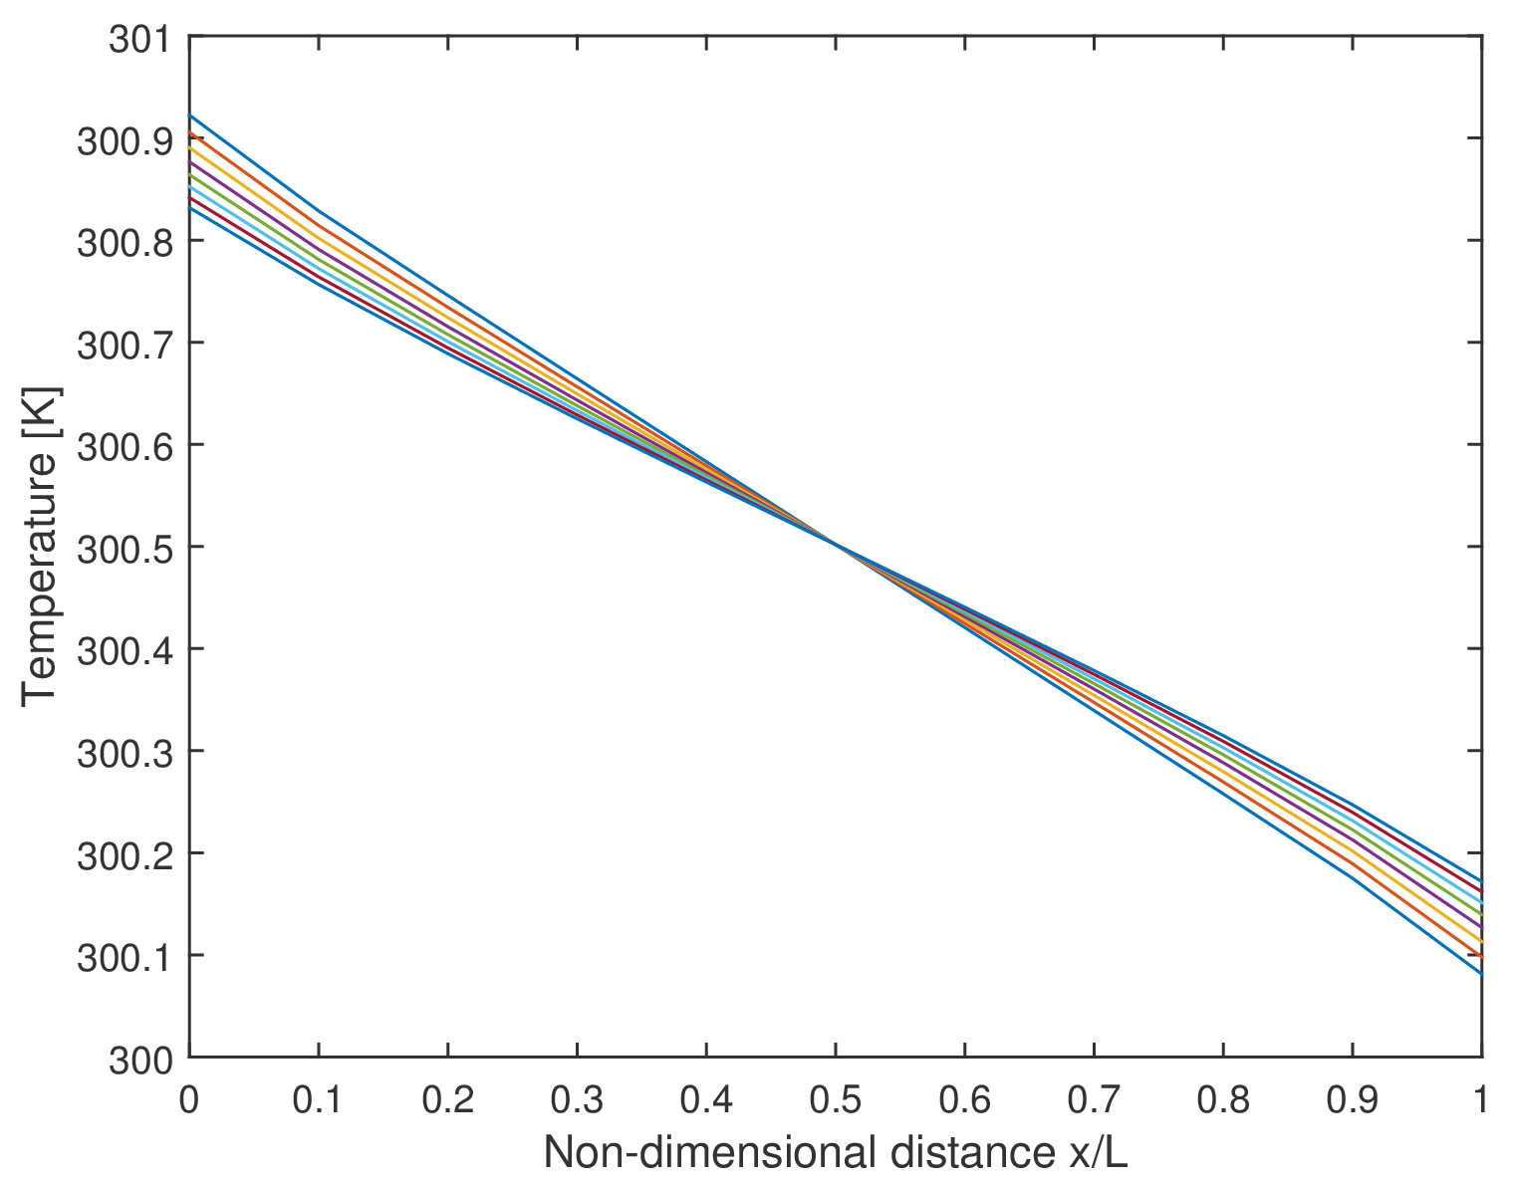
Transport in Thin Films
Implementation of PCE-SC
Method applied to obtain uncertainty in thermal conductivity
Assumed 50% range on mean free path
S₈ quadrature
Known thermal conductivity in silicon at 300 K

Slide 21
Transport in Thin Films
Scale of test problem involves scattering in two regimes
Diffuse and ballistic scattering
3x the Casimir limit in silicon
Small length scales highly influenced by size effects
Non-dimensional temperature highly linear
Approaches exact solution of EPRT
Coarse and fine mesh yield similar results
Verified implementation of uncertainty quantification method
Known value of thermal conductivity in silicon at 300 K

Slide 22
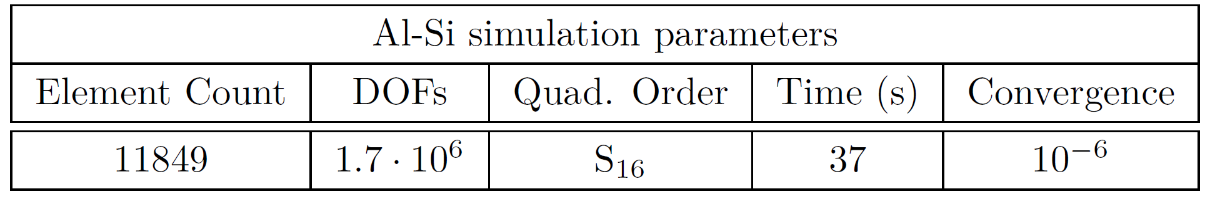
Two Material System
Two dimensional system of aluminum and silicon
250 nm x 250 nm square of silicon, T_{B} = 300 K
3.4 nm x 3.4 nm aluminum dot modeled as heat source, T_{B} = 301 K
All surfaces are phonon emitters
Lay groundwork for future multi-element systems
Investigate transient capabilities of Rattlesnake
Gauge transport performance in two materials with highly differing mean free path
Λ_{Si} = 33.8·10⁻⁹ [m]
Λ_{Al} = 2.9·10⁻⁹ [m]

Slide 23
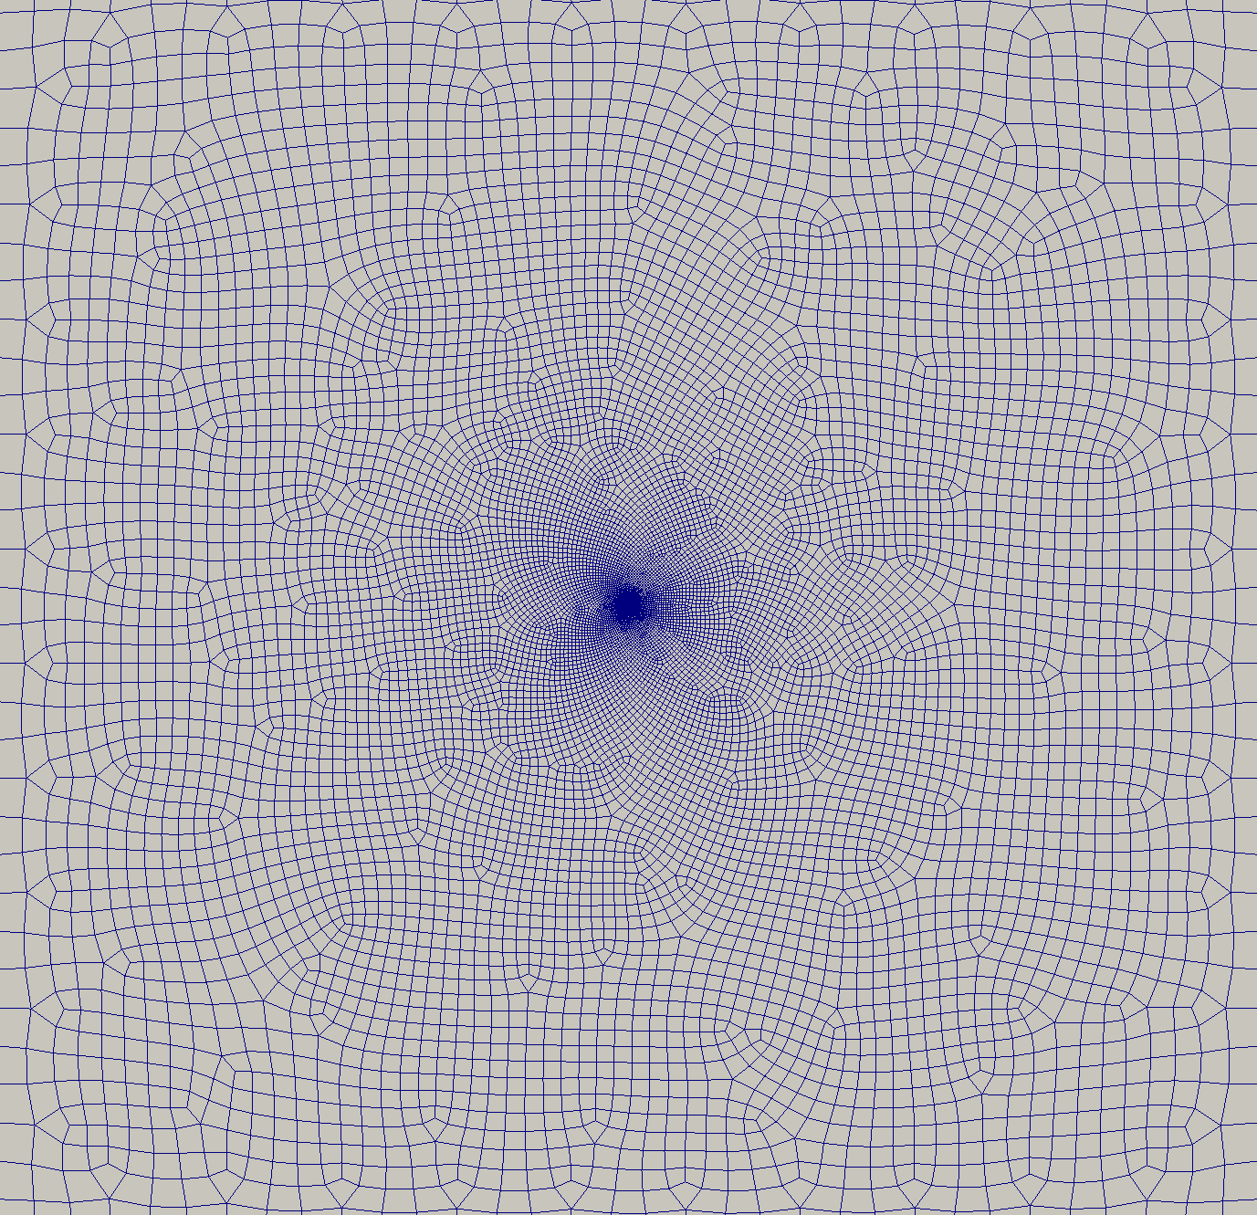
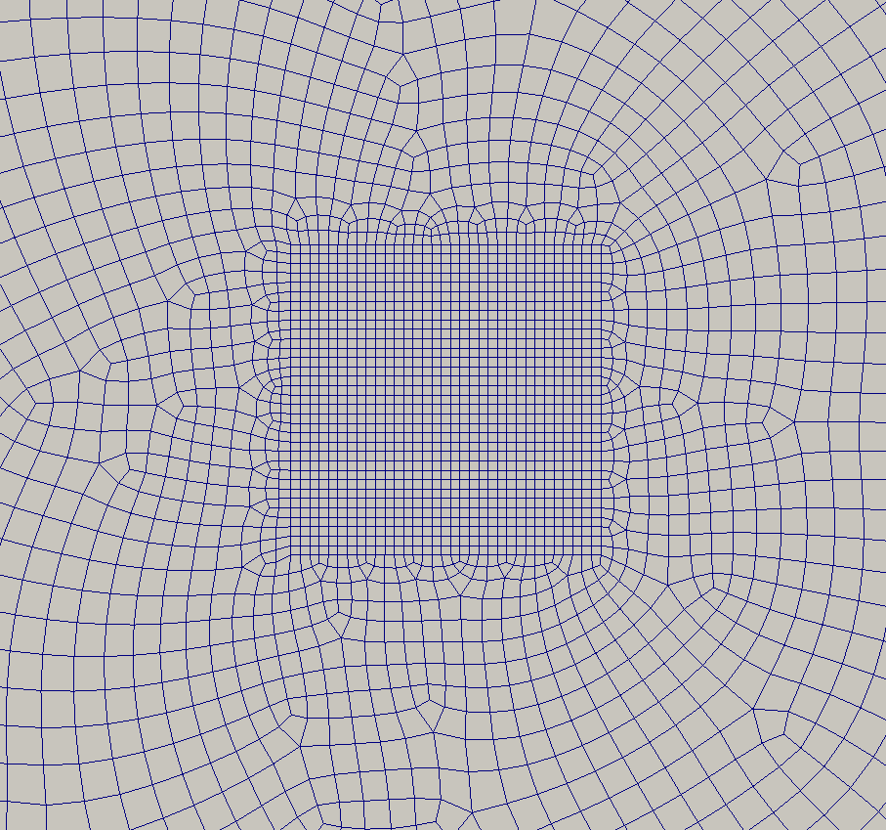
Two Material System
Aluminum-silicon mesh

Slide 24
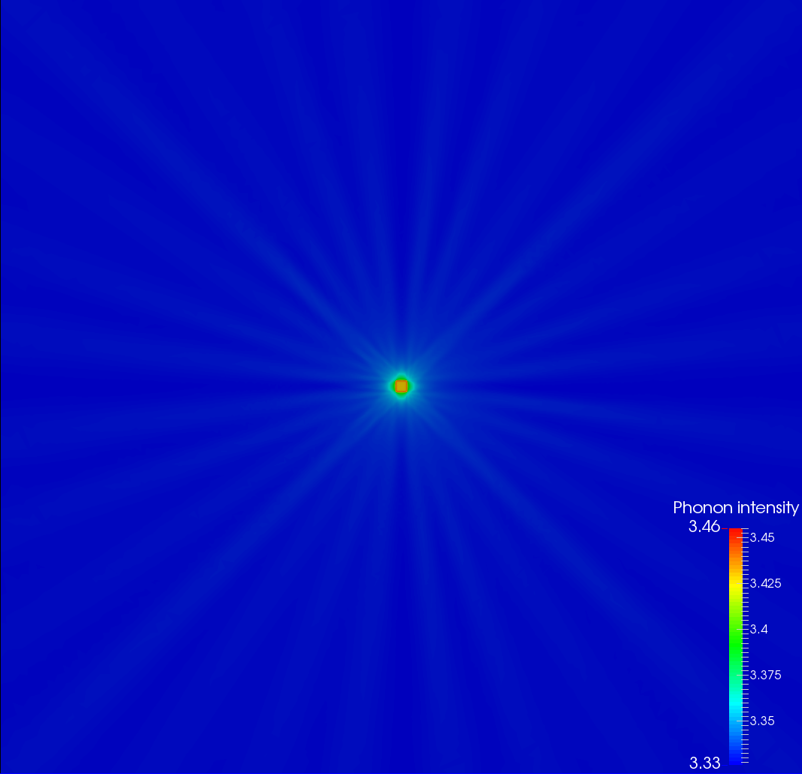
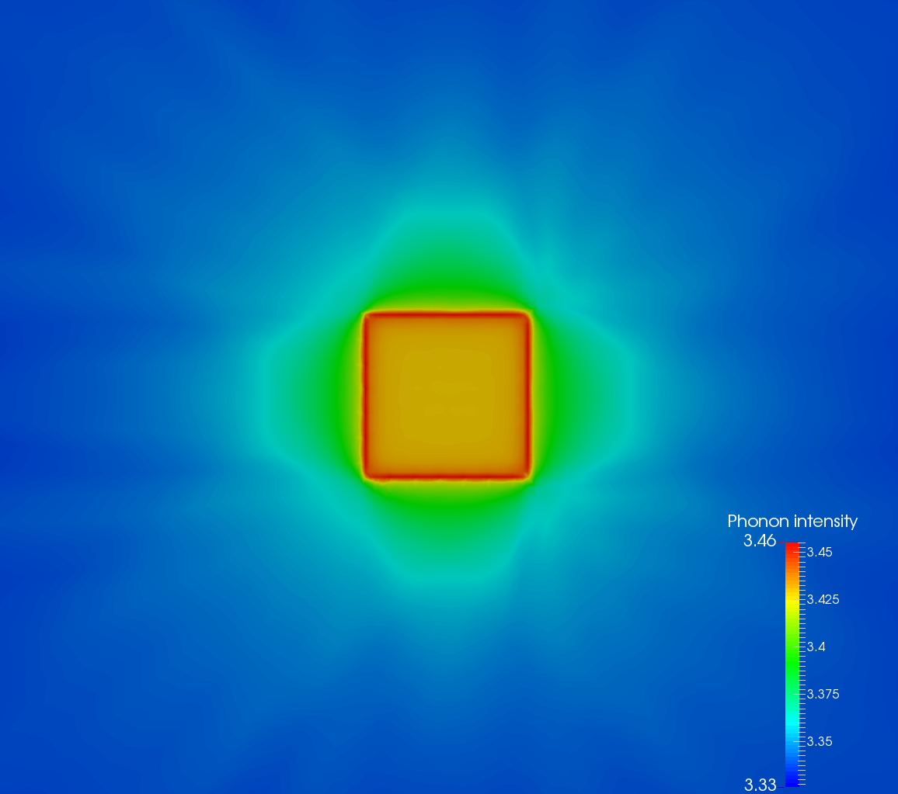
Two Material System
Phonon intensity

Slide 25
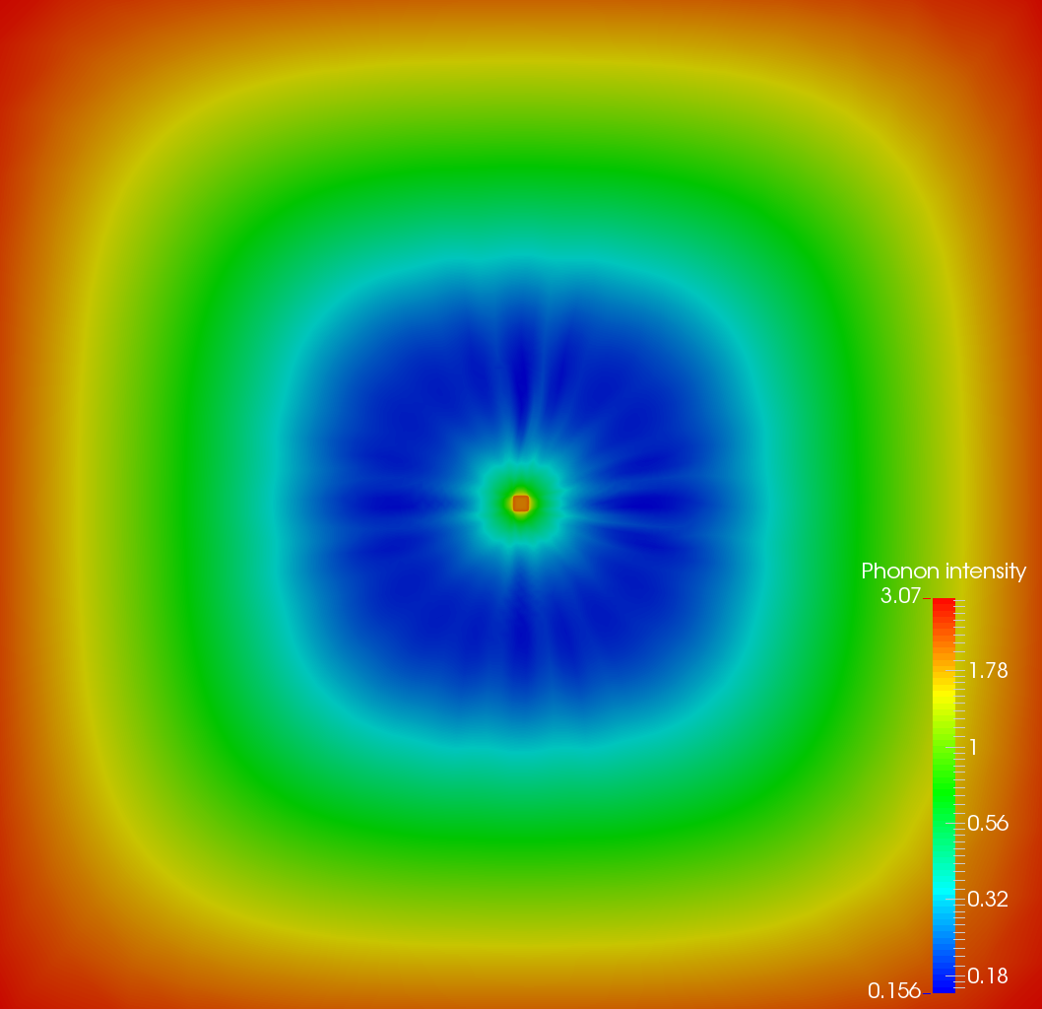
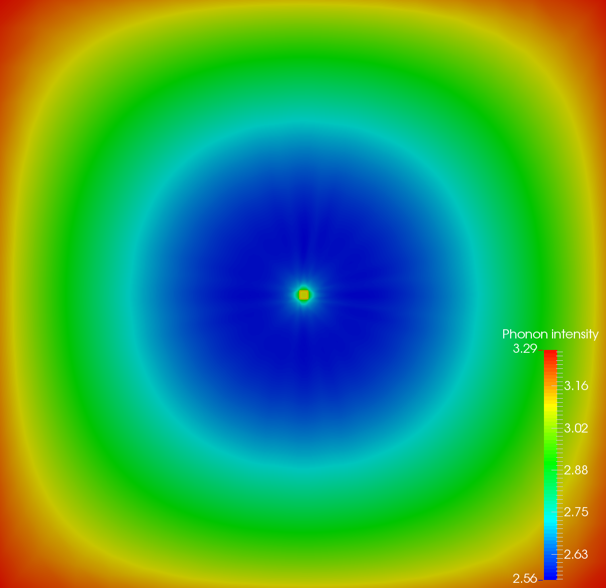
Two Material System
Transient simulation
500 ps duration
1 ps time step
Time dependent aluminum heat source in Ali and Yilbas
Al/Si transient simulation

Slide 26
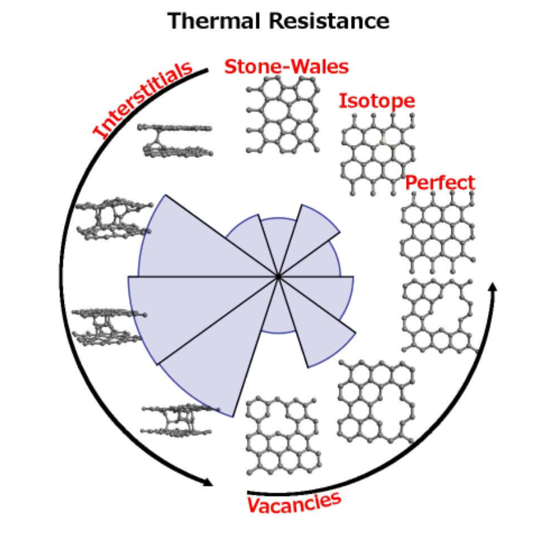
Phonon Transport in z-axis Graphite
Conducted phonon transport simulations in z-axis graphite
Collaboration with materials science researchers
Thermal conductivity is directionally dependent in graphite
Investigation of thermal resistance in graphite due to radiation induced morphological defects
Rattlesnake transport simulations provided support and validation for MD simulations

Slide 27
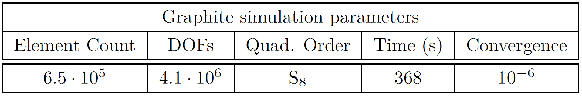
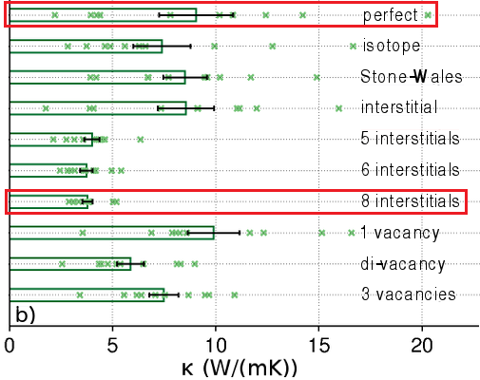
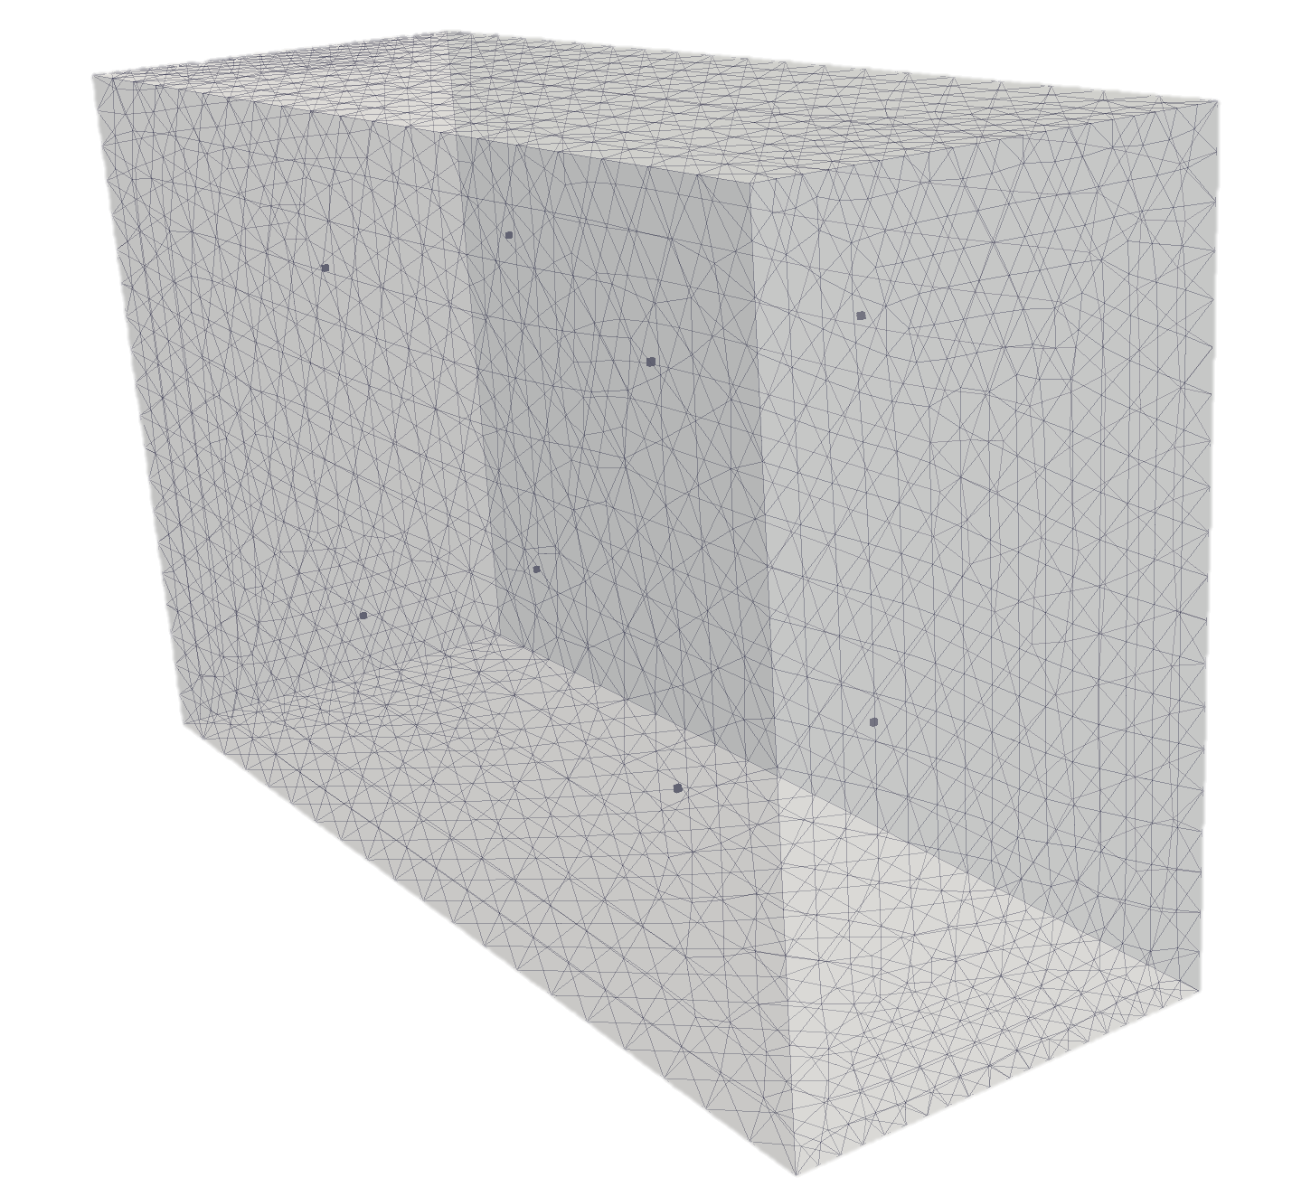
Phonon Transport in z-axis Graphite
Graphite superlattice geometry
5.41 x 9.37 x 14.8 nm
T_{L} = 301 K, T_{R} = 300 K on z-planes
x-y planes reflecting
L. de Sousa Oliveira

Slide 28
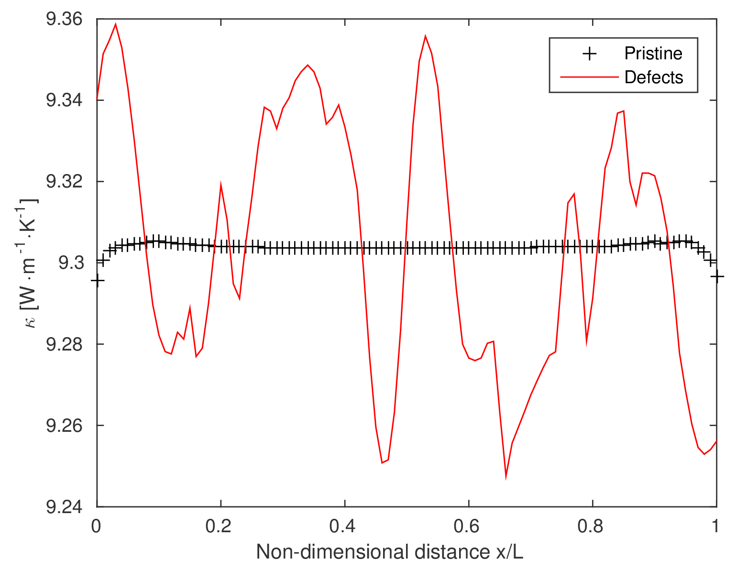
Phonon Transport in z-axis Graphite

Slide 29
Single Crystal UO₂
Gofryk et al. investigated anisotropy associated with UO₂
Anisotropy counterintuitive due to crystalline symmetry of UO₂
Anharmonic scattering at some temperature extremes
Performed MD simulations to provide comparisons to experimental results
Depleted UO₂ single crystal, 1x1x7 mm bar, annealed in Ar-6%H₂ at 850 C
Rattlesnake transport in attempt to match thermal conductivity found through experiment
Expected results provided input conditions
Mean free path extracted through kinetic theory relationship
Simulations at various cell thicknesses to quantify boundary effects
Superlattice geometry obtains equilibrium bulk thermal conductivity near that of experiment

Slide 30
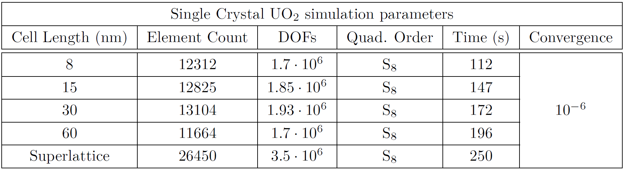
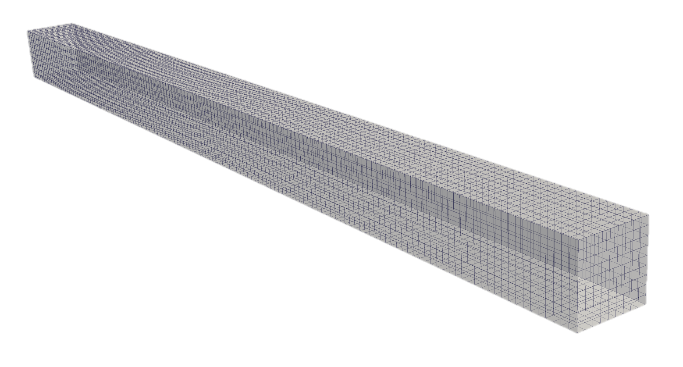
Single Crystal UO₂
Varying UO₂ cell lengths
Cross section area constant, 3.8 x 3.8 nm
T_{L} = 301 K, T_{R} = 300 K on z-planes
x-y planes reflecting

Slide 31
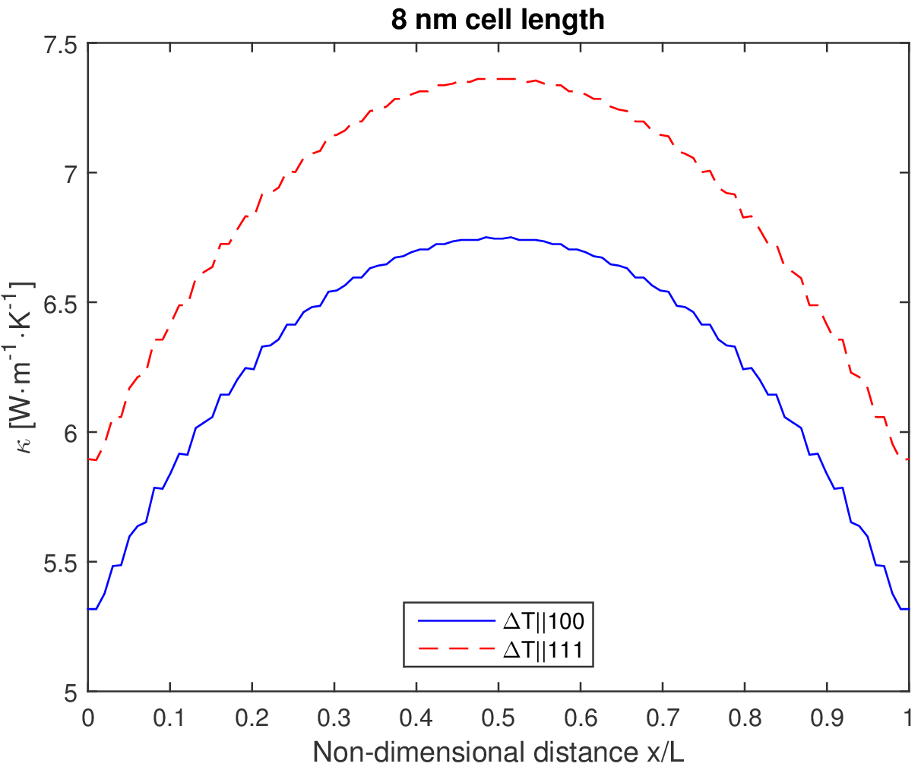
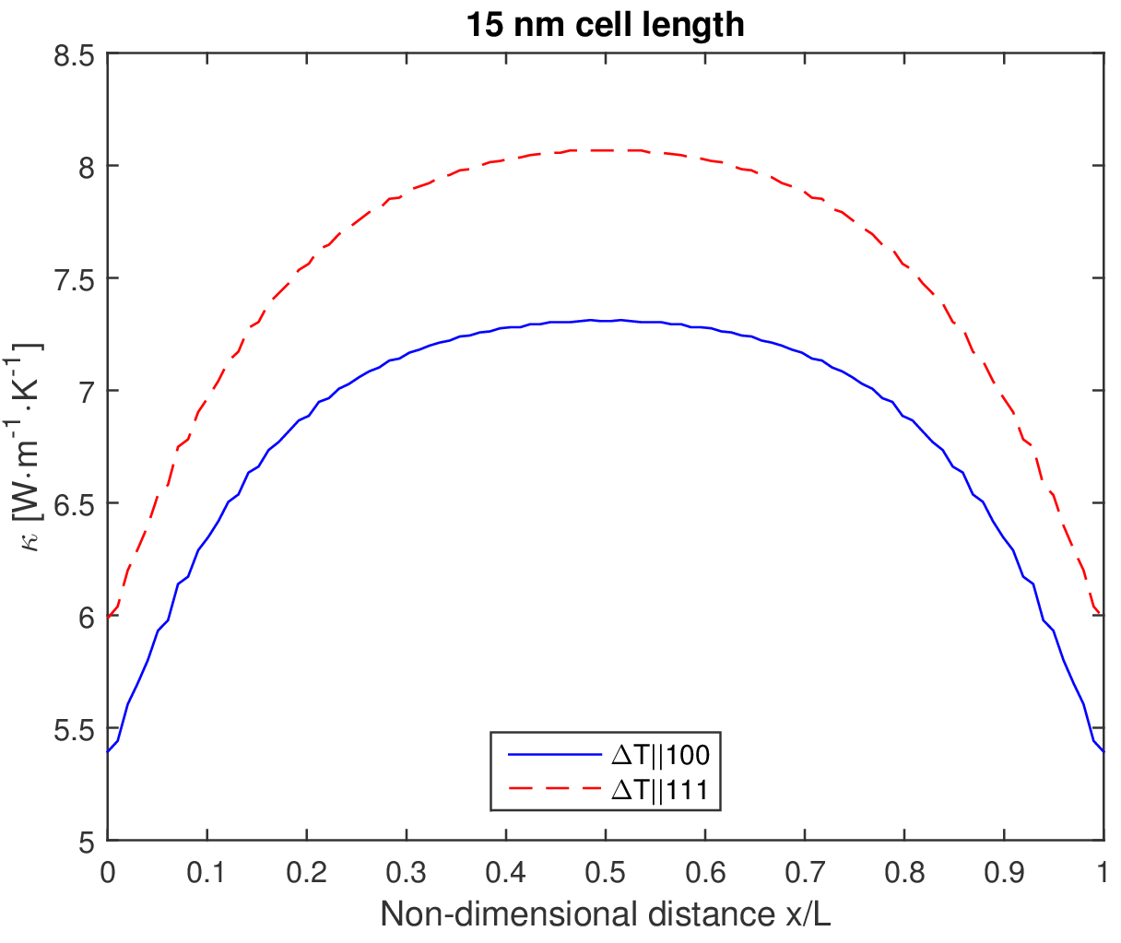
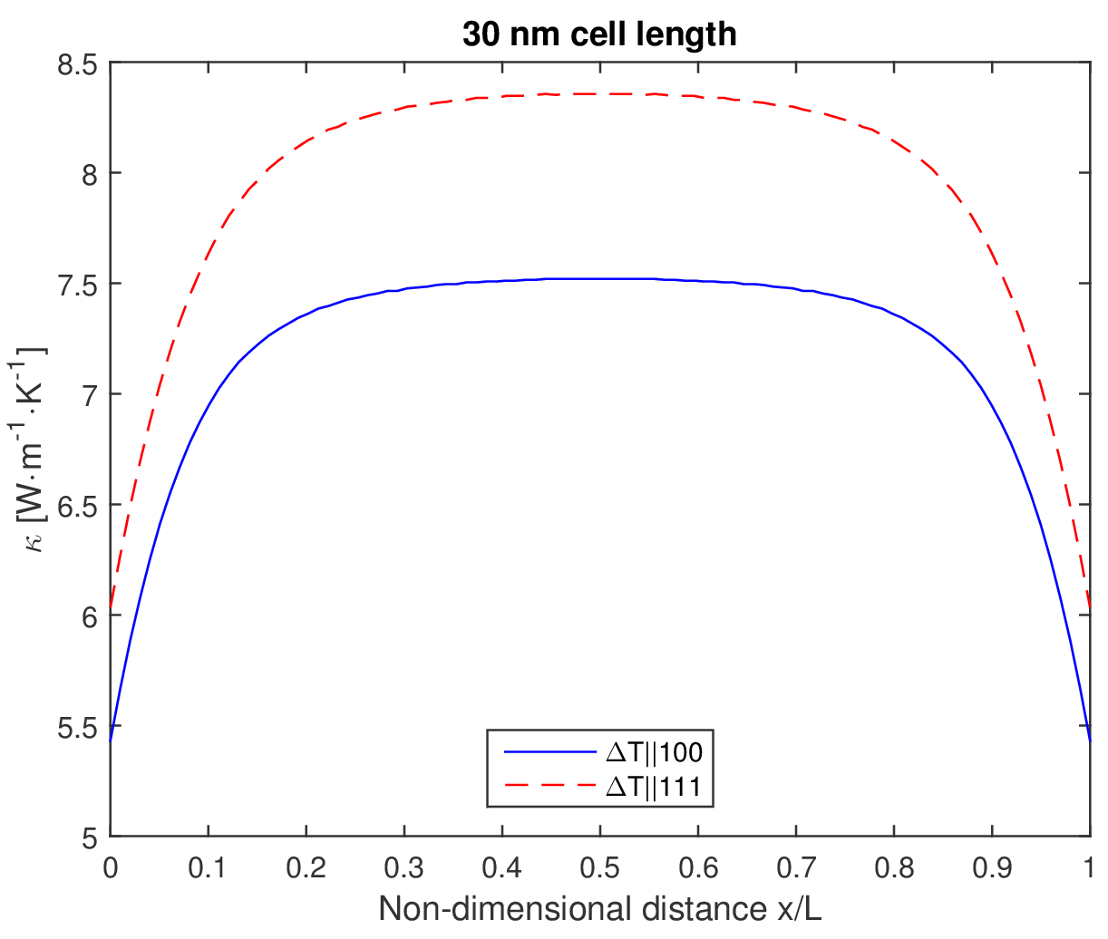
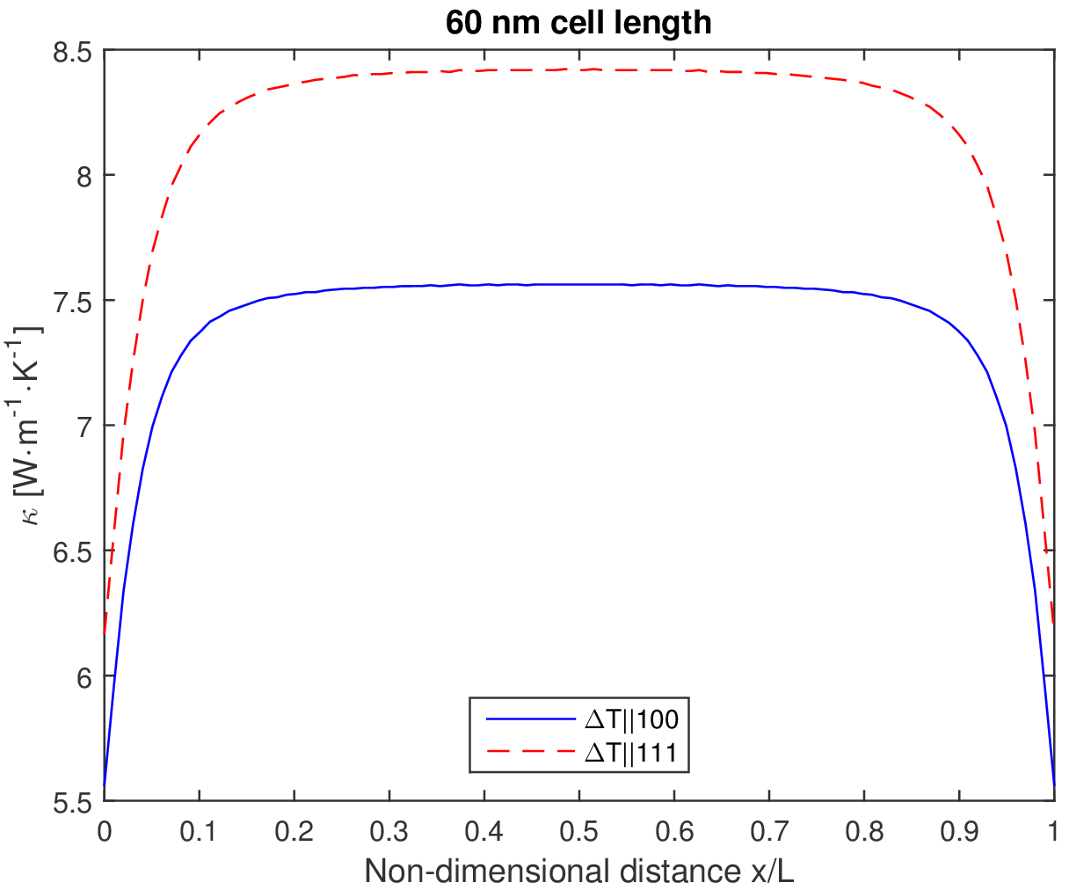
Single Crystal UO₂
Equilibrium thermal conductivity affected by cell size

Slide 32
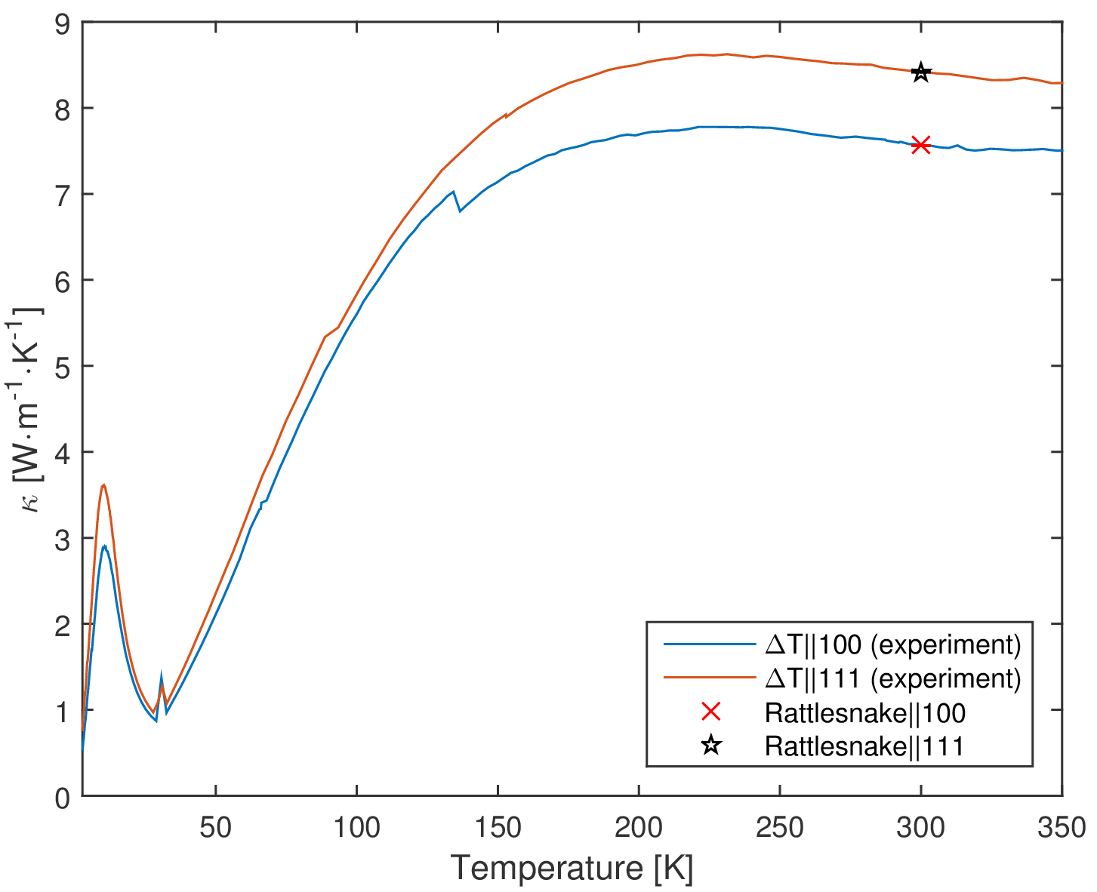
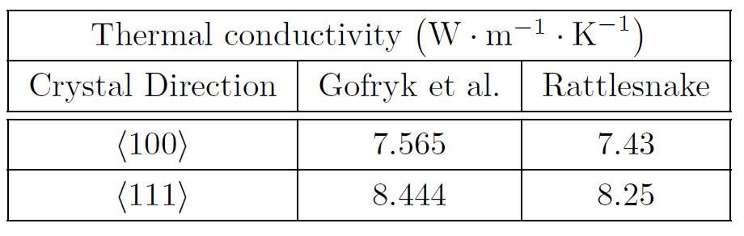
Single Crystal UO₂
Thermal conductivity in superlattice at 300 K is accurate in comparison with Gofryk et al.

Slide 33
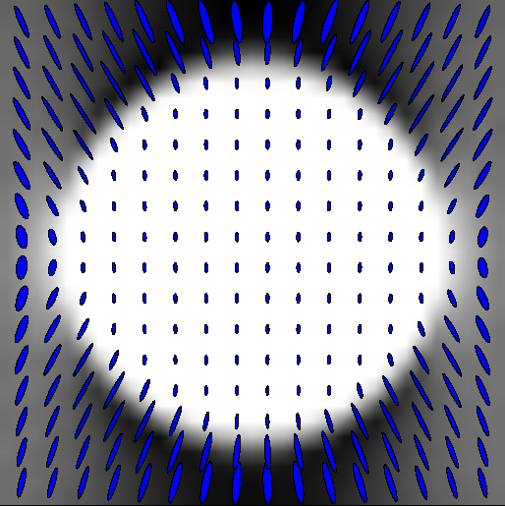
Transport in UO₂ with Xenon Defects
MD study from Los Alamos National Laboratory on the effect of xenon presence in UO₂ in altering thermal conductivity (Du et al.)
Known Λ for pristine UO₂ from Du et al., Λ for xenon determined through kinetic theory
Dulong and Petit law for specific heats (3R)
Xenon behavior in UO₂ at high temperatures and pressures
Xenon experiences extremely high pressures and density changes in UO₂
Pressures to 5 GPa
3 order of magnitude density change
Understanding at extreme conditions is limited
D. Sosa-Cabrera and J. Ruiz-Alzola

Slide 34


Transport in UO₂ with Xenon Defects
Simulation parameters
300 K, 800 K, 1500 K
3.8 x 3.8 nm cross section area
No grain boundaries
Xenon bubble r = 1 nm in center
1 K gradient on z-planes
x-y planes reflecting

Slide 35

Transport in UO₂ with Xenon Defects
Non-dimensional temperature
Xenon impurity discontinuity

Slide 36



Transport in UO₂ with Xenon Defects
Heat flux across z-axis at 300 K [animation]
Heat flux across z-axis at 800 K
Heat flux across z-axis at 1500 K

Slide 37



Transport in UO₂ with Xenon Defects
Thermal conductivity at 300 K, 800 K, 1500 K

Slide 38


Transport in UO₂ with Xenon Defects

Slide 39
Conclusions
Demonstrated phonon transport using neutron transport code
Rattlesnake can be used as a deterministic phonon transport engine
Simulated system of UO₂ with xenon defects
Some success in comparison to MD simulation results
Rattlesnake simulation not an exact replication of MD
Unable to resolve certain scattering processes
Lack of data for xenon behavior in UO₂ at lower temperatures
Provided uncertainty via PCE-SC in single variable problem
Method provides mean and variance for parameters of interest
2D PCE-SC is in development

Slide 40

Future Work
Develop Rattlesnake to model more sophisticated scattering processes
Incorporate phonon dispersion relation
Model anharmonic scattering processes
Phonon-phonon scattering
Investigate frequency dependent transport through use of multiband framework in Rattlesnake
Couple to MARMOT
Evolve the simulation microstructure by use of order parameters through the phase field module in MARMOT (in progress)
Escape from static simulation meshes
Generate mesh from initial conditions and allow microstructure evolution during transport simulation
Placement of nucleation sites for different elemental species
Void formation
Xenon production from fission
J. Rattlidge/Paignton Zoo

Slide 41


Acknowledgements
Alex Greaney, University of California – Riverside
Daniel Schwen, Idaho National Laboratory
David Andersson, Los Alamos National Laboratory
Ben Liu, Los Alamos National Laboratory
This research was supported under a Department of Energy grant in conjunction with the Idaho National Laboratory and National University Consortium

Slide 42
Questions?

